Slide 1
LECTURE 5
AUTOCAD

Slide 2
INTRODUCTION
The Word AutoCAD is made up of two words “Auto(logo of company)”and CAD “(computer aided design)”.
AutoCAD is 2D and 3D modeling software.
It is developed by Autodesk company.
Autodesk is an U.S.A based company.
It is widely used in industry for 2D drawing and 3D modeling.
In another way we can say that AutoCAD is a designing course , which is performed by the help of computer.
VERSION OF AUTOCAD
AutoCAD software was firstly launched by Autodesk company in Dec. 1982.
It comes in India in 1988. T
The first version of AutoCAD was R1 after that R2,R3,R4…………… and so on.
In 2000,Autodesk launched a version of AutoCAD 2000 after that 2001,2002…… so on.

Slide 3
USER INTERFACE

Slide 4
FUNCTION KEYS
Key | Feature | Description
F1 | Help | Displays Help for the active tooltip, command, Palette or dialog box.
F2 | Expanded History | Displays an expanded command history in the Command window
F3 | Object Snap | Turns object snap ON and OFF
F4 | 3D Object Snap | Turns additional object snaps for 3D ON and OFF
F5 | Isoplane | Cycles through 2D isoplane settings (Top, Right and Left)
F6 | Dynamic UCS | Turns automatic UCS alignment with planar surfaces ON and OFF
F7 | Grid display | Turns the grid display ON and OFF
F8 | Ortho | Locks cursor movement to horizontal or vertical
F9 | Grid Snap | Restricts cursor movement to specified grid intervals
F10 | Polar Tracking | Guides cursor movement to specified angles
F11 | Object Snap Tracking | Tracks the cursor horizontally and vertically from object snap locations
F12 | Dynamic input | Displays distances and angles near the cursor and accepts input as we use Tab between fields

Slide 5
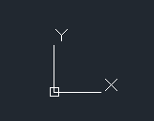
STATUS BAR
Axes

Slide 6
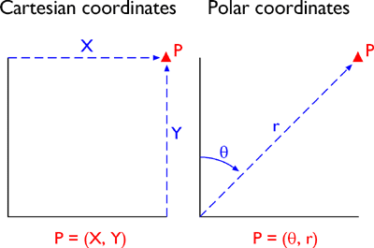
COORDINATE SYSTEM
There are 2 types of Coordinate System
Absolute or Cartesian Coordinate System
Absolute coordinates refers to a Cartesian System that uses x-axis, y-axis, and sometimes a z-axis to establish a point some distance from a common origin. (x,y)
2. Polar Coordinate System
The polar coordinate system is a two-dimensional coordinate system in which each point on a plane is determined by a distance from a reference point and an angle from a reference direction (r,θ)

Slide 7
COORDINATE SYSTEM
1. Absolute Coordinate System
In the absolute coordinate system the points are located with respect to the origin (0,0).
The format for Absolute Coordinate System is (x,y)
2. Relative Coordinate System
There are two types of relative coordinates
Relative Rectangular Coordinates
In the relative coordinate system the points are located with respect to the last point drawn.
The format for Relative Rectangular Coordinates is @(x,y)
b. Relative Polar Coordinates
In the relative polar coordinate system, a point can be located by defining both the distance of the point from the current point and the angle that the line between the two points makes with the positive X axis.
The format for Relative Rectangular Coordinates is @Distance < Angle

Slide 8

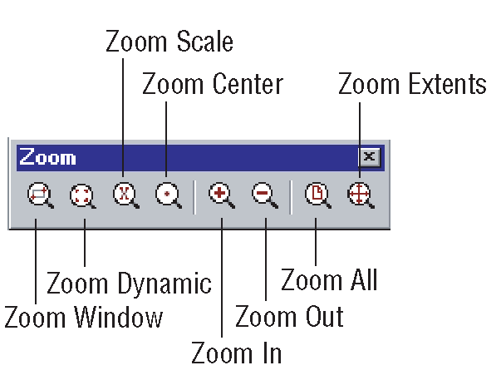
.
Pan – P
The Pan command moves the observer and focus point relative to a fixed model position. Imagine that you are looking straight ahead and moving laterally left/right or up/down. The image will move opposite to the panning direction. ... Drag (left click and hold) up or down, or arrow up or down, to pan up and down.
Zoom – Z
Increases or decreases the magnification of the view in the current viewport

Slide 9
DRAW TOOLBAR
Commands
Line – L
Polyline – PL
Circle – C
Arc – A
Rectangle – REC
Ellipse – EL
Polygon – POL
Spline – SPL
Point – PO
Hatch – H
Multiline Text – MTEXT
Block – B
Write Block - WB

Slide 10
MODIFY TOOLBAR
Commands
Erase – E
Copy – CO
Mirror – MI
Offset – O
Array – AR
Move – M
Rotate – RO
Scale – SC
Fillet – F
Chamfer – CHA
Trim – TR
Extend – EX

Slide 11
DIMENSIONING & layer TOOLBARs
DIMENSIONING TOOLBAR
Commands
Dimension – DIM
The commands for linear, aligned, angular, etc will be given as first DIM and then the respective command.
For example,
Linear – DIMLIN
Aligned – DIMALI
Angular – DIMANG
LAYER TOOLBAR
Layer - LA

Slide 12
Other used Toolbars in AutoCAD are:
Format Menu
Commands used are Dimension Style, Point Style, Text Style
Properties Tool Bar
Parametric Menu
Commands used are Geometrical Constraints, Dimensional Constraints

